Slide 1
Unit 8 Vocabulary
Week of December 10th
Mrs. Cushman ELA

Slide 2
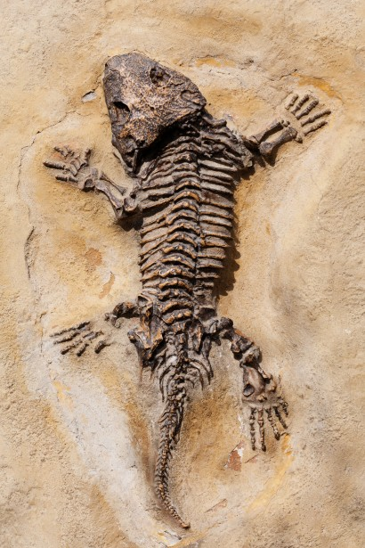
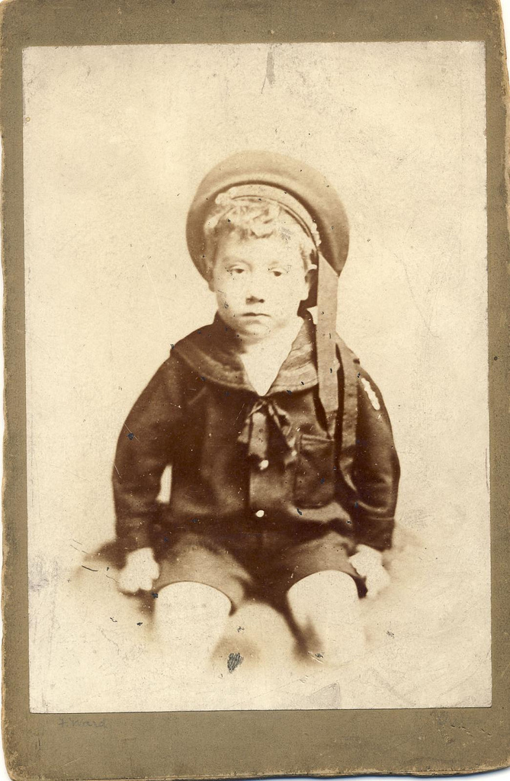
ancient
Very old
Early in history
The fossil remains are ancient.

Slide 3
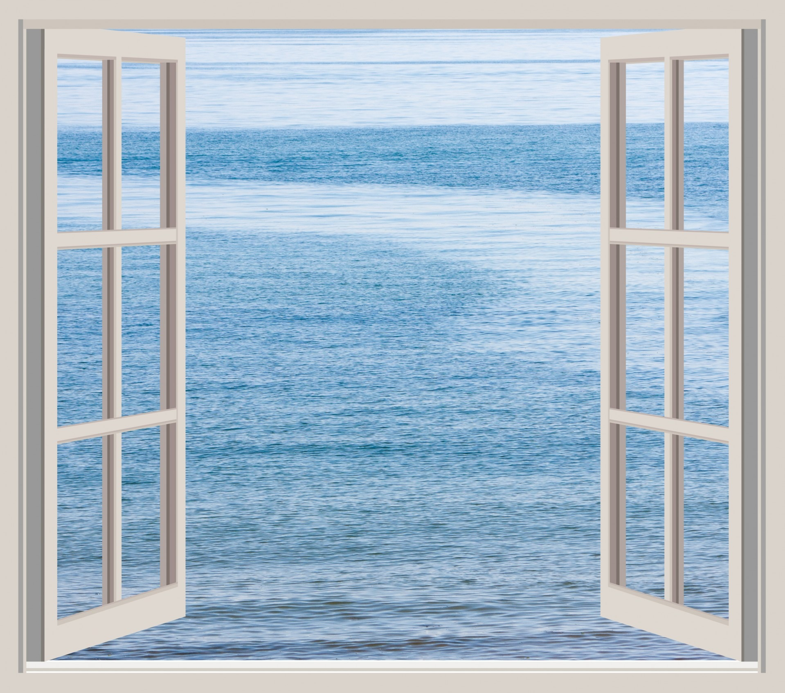
expose
To uncover or open to view
To make something known
I promise not to expose their secret.

Slide 4
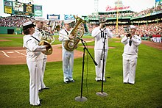
perform
To carry out a task
To act or entertain
The couple was asked to perform the play on Wednesday.

Slide 5
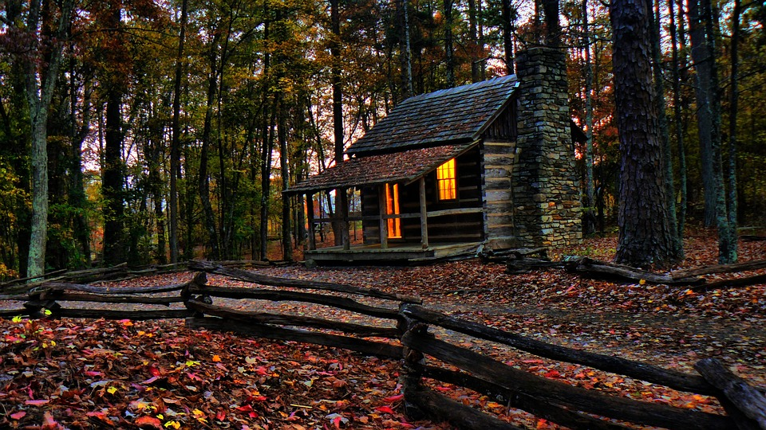
remote
Far removed in distance or time
Our of the way
Unlikely very slight
We drove to a remote cabin in the woods.

Slide 6
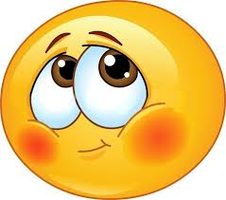
timid
Lacking courage or confidence
I was too timid to talk to the new teacher.

Slide 7
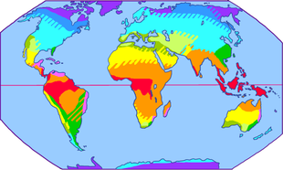
climate
The usual weather conditions of a place
I don't like that moist, hot climate.

Slide 8
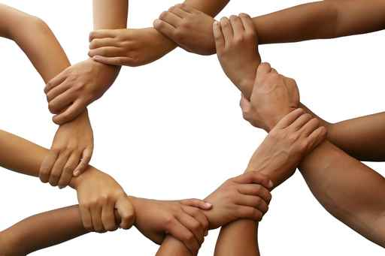
cling
To hold on firmly
To have a strong attachment to or feeling for something or someone
As a child, I used to cling to my mother.

Slide 9
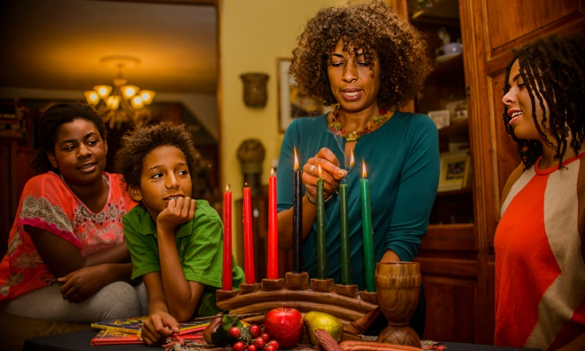
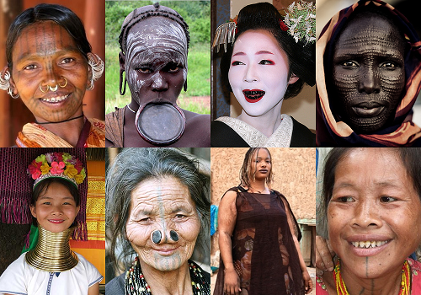
custom
A common practice
The way people do things year after year
Eating turkey and stuffing is a custom celebrated by many people on Thanksgiving.

Slide 10
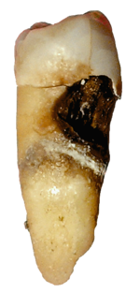
decay
To slowly decline
Fall into ruin
The slow decline of something; a wearing away
The salt water caused the dock to decay.
Go to the dentist twice a year to try to avoid tooth decay.

Slide 11
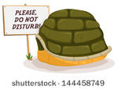
disturb
To make upset or uneasy
We tried not to disturb their sleep.

